Slide 1
GPUs and CUDA 3 Intrinsics
CS121 Parallel Computing
Fall 2022

Slide 2
Race conditions
Race condition: Different outcomes depending on execution order.
Race conditions can occur in any concurrent system, including GPUs.
Code should print a =1,000,000.
But actually printed a = 88.
GPUs have atomic intrinsics for simple atomic operations.
Hard to implement general mutex in CUDA.
Codes using critical sections don’t perform well on GPUs anyway.
__global__ void raceKernel(int *d_a) {
*d_a += 1;
}
void main() {
int a = 0; *d_a;
cudaMalloc((void **) &d_a, sizeof(int));
cudaMemcpy(d_a, &a, sizeof(int),
cudaMemcpyHostToDevice);
raceKernel<<<1000, 1000>>>(d_a);
cudaMemcpy(&a, d_a, sizeof(int),
cudaMemcpyDeviceToHost);
printf("a = &d\n", a);
cudaFree(d_a);
}

Slide 3
CUDA atomics
Can perform atomics on global or shared memory variables.
int atomicInc(int *addr)
Reads value at addr, increments it, returns old value.
Hardware ensures all 3 instructions happen without interruption from any other thread.
int atomicAdd(int *addr, int val)
Reads value at addr, adds val to it, returns old value.
int atomicMax(int *addr, int val)
Reads value at addr, sets it to max of current value and val, returns old value.
int atomicExch(int *addr1, int val)
Sets val at addr to val, returns old value at val.
int atomicCAS(int *addr, old, new)
“Compare and swap”, a conditional atomic.
Reads value at addr. If value equals old, sets value to new. Else does nothing.
Indicates whether state changed, i.e. if your view is up to date.
Universal operation, i.e. can be used to perform any other kind of synchronization.

Slide 4
Finding max of array
A grid of threads computes the max of an array in global memory.
__global__ void max(int *vals, int* global_max) {
int i = threadIdx.x + blockDim.x * blockIdx.x;
int val = vals[i];
atomicMax(global_max, val);
}
Works correctly, no race conditions.
Ex Thread 1 tries to set global_max to 4, thread 2 tries to set it to 5.
If thread 1 goes, then thread 2, global_max becomes 4 then 5.
If thread 2 goes, then thread 1, global_max becomes 5, stays 5.

Slide 5
Atomics performance
__global__ void max(int *vals, int* global_max) {
int i = threadIdx.x + blockDim.x * blockIdx.x;
int val = vals[i];
atomicMax(&global_max, val);
}
Problem is this code is really slow.
When multiple threads perform atomic operation on same variable, they get serialized.
Many threads may update global_max at same time. Execution becomes sequential instead of parallel.
Even with no contention, atomic operation somewhat slower than regular operation.

Slide 6
Improving performance
__global__ void max(int *vals, int* global_max, int *local_max, int num_locals) {
int i = threadIdx.x + blockDim.x * blockIdx.x;
int val = vals[i];
int locali = i % num_locals;
int old_max = atomicMax(&local_max[locali], val);
if (old_max < val) {
atomicMax(&global_max, val);
}
}
Split the single global max into num_locals number of local max values.
Thread i atomically maxes with its local max, local_max[locali].
Only if it increased the local max does thread try to increase the global max.
Local max usually won’t increase, so rarely need to update global max.
Spread out contention to the local maxes, reduce frequency of updates to global max.
Still doesn’t perform that well. A reduction tree is more efficient.

Slide 7
Computing a histogram
Given an array of values from 0 to k, count the number of each value.
Ex [0,0,1,0,1] ⇒ [3,2], i.e. three 0’s and two 2’s.
vals
0 | 3 | 1 | 1 | 0 | 2 | 3 | 2
hist
__global__ void hist(unsigned char *vals, int size, int *hist) {
int i = threadIdx.x+ blockIdx.x* blockDim.x;
int stride = blockDim.x* gridDim.x;
while (i< size) {
atomicAdd(&(hist[vals[i]]), 1);
i += stride;
}}

Slide 8
Improving performance
Hist array stored in global memory, so access is slow.
Since all threads write to same array, contention can be high.
Better to make local histogram in shared memory for each thread block, add result to global histogram at the end.
Atomic ops on shared memory faster.
Fewer threads per block so less contention on local_hist.
Only one atomic op on global histogram per value instead of many increments.
__global__ void hist(unsigned char *vals, int size, int *hist) {
// Assume 256 different vals
__shared__ int local_hist[256];
if (threadIdx.x < 256)
local_hist[threadIdx.x] = 0;
__syncthreads();
int i = threadIdx.x+ blockIdx.x* blockDim.x;
int stride = blockDim.x* gridDim.x;
while (i< size) {
atomicAdd(&(local_hist[vals[i]]), 1);
i += stride;
}
__syncthreads();
if (threadIdx.x < 256)
atomicAdd(&(hist[threadIdx.x]), local_hist[threadIdx.x]);
}

Slide 9
Aggregation and atomics
Want threads to aggregate data into a shared structure.
Ex Filtering. Given a source array src with n elements, and a predicate, copy all elements of src satisfying predicate into destination dst.
In our examples, we copy all positive values.
Consider four methods
Global memory atomicAdd.
Shared memory atomicAdd.
Scan based filtering using Thrust’s copy_if().
Warp-aggregated filtering.
int filter(int *dst, const int *src, int n) {
int nres = 0;
for (int i = 0; i < n; i++)
if (src[i] > 0)
dst[nres++] = src[i];
return nres; }
Sequential
__global__
void filter_k(int *dst, int *nres, const int *src, int n) {
int i = threadIdx.x + blockIdx.x * blockDim.x;
if(i < n && src[i] > 0)
dst[atomicAdd(nres, 1)] = src[i]; }
Global memory atomics
Source: https://devblogs.nvidia.com/parallelforall/cuda-pro-tip-optimized-filtering-warp-aggregated-atomics/

Slide 10
Aggregation and atomics
__global__
void filter_shared_k(int *dst, int *nres, const int* src, int n) {
__shared__ int l_n;
int i = blockIdx.x * (NPER_THREAD * blockDim.x) + threadIdx.x;
for (int iter = 0; iter < NPER_THREAD; iter++) {
// zero the counter
if (threadIdx.x == 0)
l_n = 0;
__syncthreads();
// get the value, evaluate the
// predicate, and increment the
// counter if needed
int d, pos;
if (i < n) {
d = src[i];
if(d > 0)
pos = atomicAdd(&l_n, 1);
}
__syncthreads();
// leader increments the global
// counter
if (threadIdx.x == 0)
l_n = atomicAdd(nres, l_n);
__syncthreads();
// threads with true predicates
// write their elements
if (i < n && d > 0) {
pos += l_n; // increment local pos
// by global counter
dst[pos] = d;
}
__syncthreads();
i += blockDim.x;
}
}
Shared memory atomics
Each block uses local index l_n, then merges with global counter nres.

Slide 11
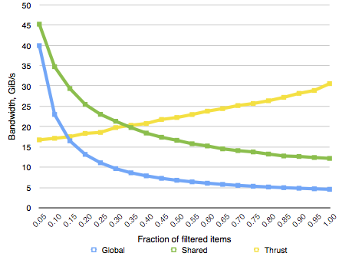
Aggregation and atomics
Global memory atomics has very poor performance.
Performance degrades as more elements satisfy filter, due to conflicts.
Shared memory over 2X better, but performance still degrades.
Scan based filtering in Thrust has large up front cost.
But performance actually improves as filtered items increase, due to higher GPU utilization.

Slide 12
Warp-aggregated atomics
Warp-based aggregation lets threads in a warp add their private values into a shared counter using fewer atomic adds.
Threads in the warp elect a leader.
Threads compute a total atomic increment for the warp.
Leader thread performs an atomic add, and gets the old global offset value.
Leader broadcasts global offset to all threads in warp.
Each thread adds its own local offset to global offset to get its final array index.
filter values
0 | 1 | 1 | 0 | 0 | 1 | 1 | 1
old offset
new offset
X | X | X | X
local offsets
0 | 1 | 2 | 0 | 0 | 3 | 4 | 5

Slide 13
Warp-aggregated filtering
__device__
int atomicAggInc(int *ctr) {
// mask of active lanes
int mask = __ballot(1);
// select the leader
int leader = __ffs(mask) – 1;
// leader does the update
int res;
if (lane_id == leader)
res = atomicAdd(ctr, __popc(mask));
// broadcast result
res = __shfl(res, leader);
// each thread computes its own value
return res + __popc(mask & ((1 << lane_id) – 1));
}
Lane is a thread’s index within the warp (0 to 31).
Compute as threadIdx.x % 32.
Want lowest active lane (i.e. thread with positive src value) to be leader.
__ballot(v) intrinsic returns a 32 bit mask indicating whether v is true at each lane.
So __ballot(1) selects the active lanes.
__ffs(mask) intrinsic finds first set bit in mask.
__popc(mask) intrinsic counts the number of set bits in mask.
__shfl(res, leader) intrinsic lets leader broadcast res to all other threads in warp.
mask & ((1 << lane_id) – 1) keeps only the set bits in mask before the lane_id’th bit.
Ex If mask = 10100110, lane_id = 4, then this sets mask to 0000110.
__popc(mask & ((1 << lane_id) – 1)) counts number of threads satisfying predicate with lower ID.
__global__ void filter_k(int *dst, const int *src, int n) {
int i = threadIdx.x + blockIdx.x * blockDim.x;
if (i >= n)
return;
if (src[i] > 0)
dst[atomicAggInc(nres)] = src[i];
}

Slide 14
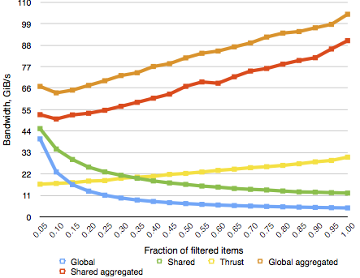
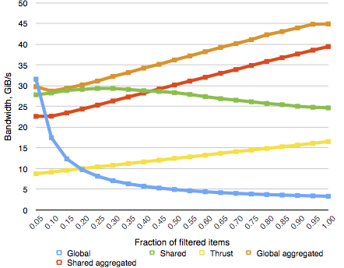
Performance
Tesla K40 (Kepler)
GeForce GTX 750 Ti (Maxwell)
Up to 100 GB/s bandwidth on Kepler (simply copying has 180 GB/s).
Performance improves with filter ratio, because more elements written.
Global memory aggregation even faster than shared memory.
Maxwell provides very efficient shared memory atomics, so the atomicAdd method is competitive for small filter ratios.
This particular Maxwell only had 5 SMs, hence the low overall performance.

Slide 15
Shuffle intrinsics
Starting from Kepler, shuffle operations allow very fast moving of data between threads in a warp.
Again, let lane = threadIdx.x % 32.
Four shuffle operations.
int __shfl_up(int var, int delta)
var is a local register variable.
Copy value of var from a thread that’s delta lanes lower than this thread.
Threads above lane 31-delta don’t do anything.
int __shfl_down(int var, int delta)
int __shfl_xor(int var, int laneMask)
Do XOR of laneMask with this thread’s lane to determine lane to copy var from.
int __shfl(int var, int srcLane)
Copy var from lane srcLane.
Can only read value from an active thread doing the shuffle instruction.
Copying from inactive thread leads to undefined behavior.
Be careful using shuffle on branching code.

Slide 16
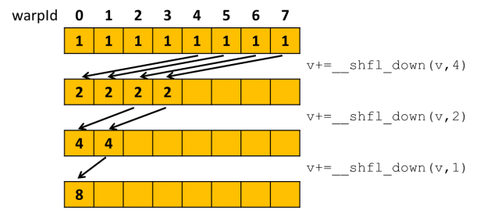
Shuffle warp reduce
Source: https://devblogs.nvidia.com/parallelforall/faster-parallel-reductions-kepler/
Can do reduce using shuffle instead of shared memory.
Can be 2-3X faster than moving same data using shared memory.
Also frees up shared memory for other uses.
Since warp is SIMD, threads are automatically synchronized after shuffle, without need for __syncthreads().

Slide 17
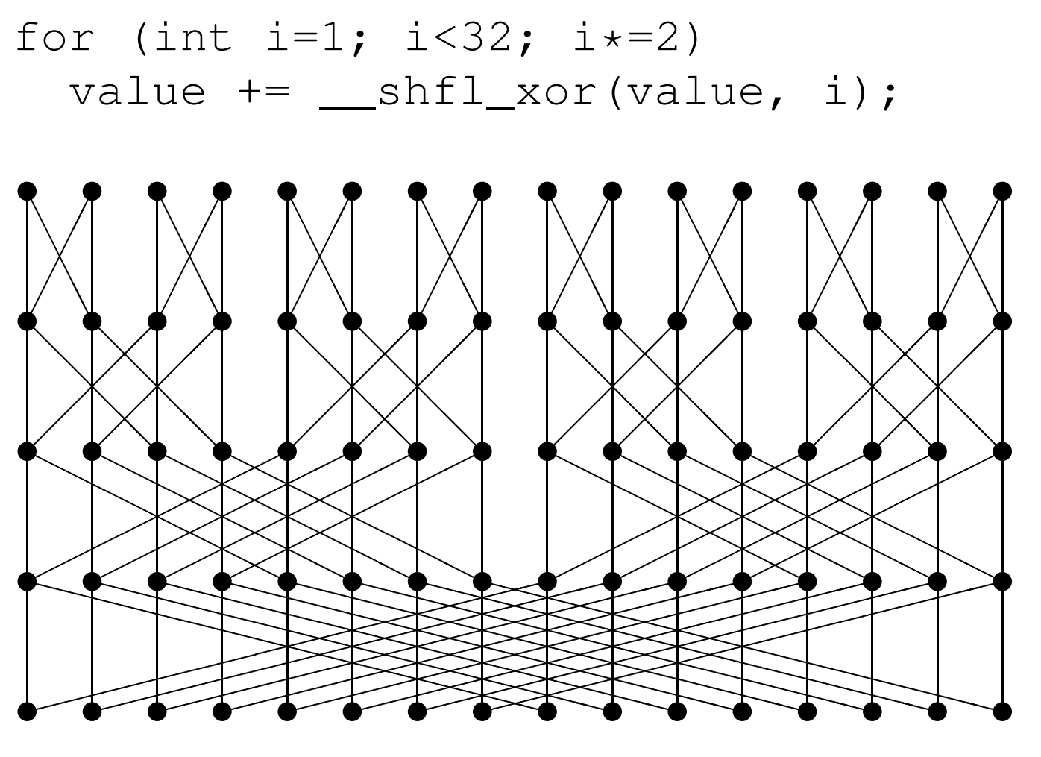
Shuffle warp all-reduce
Source: https://people.maths.ox.ac.uk/gilesm/cuda/lecs/lec4.pdf

Slide 18
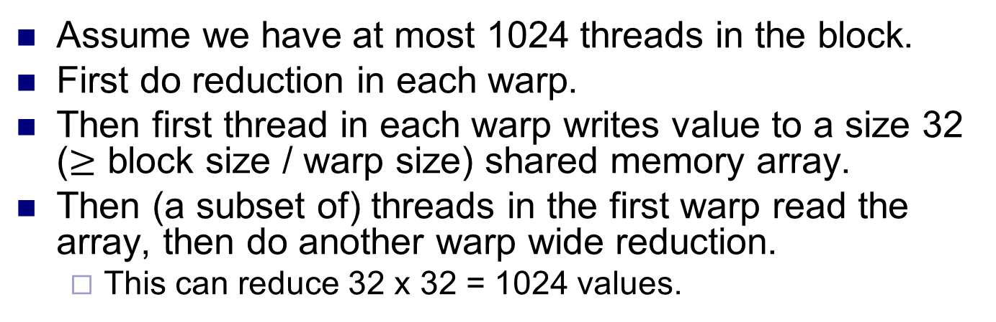
Block reduce
__inline__ __device__ int blockReduceSum(int val) {
static __shared__ int shared[32]; // Shared mem for 32 partial sums
int lane = threadIdx.x % warpSize;
int wid = threadIdx.x / warpSize;
val = warpReduceSum(val); // Each warp performs partial reduction
if (lane==0) shared[wid]=val; // Write reduced value to shared memory
__syncthreads(); // Wait for all partial reductions
//read from shared memory only if that warp existed
val = (threadIdx.x < blockDim.x / warpSize) ? shared[lane] : 0;
if (wid==0) val = warpReduceSum(val); // Final reduce within first warp
return val;
}
Assume we have at most 1024 threads in the block.
First do reduction in each warp.
Then first thread in each warp writes value to a size 32 ($≥$ block size / warp size) shared memory array.
Then (a subset of) threads in the first warp read the array, then do another warp wide reduction.
This can reduce 32 x 32 = 1024 values.

Slide 19
Reducing larger arrays
__global__ void deviceReduceKernel(int *in, int* out, int N) {
int sum = 0;
//reduce multiple elements per thread
for (int i = blockIdx.x * blockDim.x + threadIdx.x; i < N;
i += blockDim.x * gridDim.x) {
sum += in[i]; }
sum = blockReduceSum(sum);
if (threadIdx.x==0)
out[blockIdx.x]=sum;
}
void deviceReduce(int *in, int* out, int N) {
int threads = 512;
int blocks = min((N + threads - 1) / threads, 1024);
deviceReduceKernel<<<blocks, threads>>>(in, out, N);
deviceReduceKernel<<<1, 1024>>>(out, out, blocks);
}
Run two kernels, first in which every block produces a sum, and the second to add up the block sums.
Assume at most 1024 thread blocks.
Each thread in grid first sums array elements in strides of the grid size.
Number of threads in the grid is T = blockDim.x * gridDim.x.
Each thread sums every T’th array element.
First thread in each block writes block sum to array out.
Run second kernel with one thread block to sum up the ≤ 1024 block sums.

